Slide 1




Course Title:Internet of Things Lab
Course No: CSE-4264
RFID-Enabled Smart Water Dispensing System with Card Control and Live Billing Usage Tracking

Slide 2



02
Research
participants
Group 04
Saadman Salman Saad
20210104114
Abdullah Al Maruf
20210104116
Sharun Tawsif
20210104124
Nafisa Tabassum Shouty
20210104127

Slide 3


List of Contents
03
Problem Statement
List of Required Equipment
Project Description
System Diagram or Flowchart
Solution Approach
Literature Review
Key Features
Gap Analysis
Conclusion

Slide 4

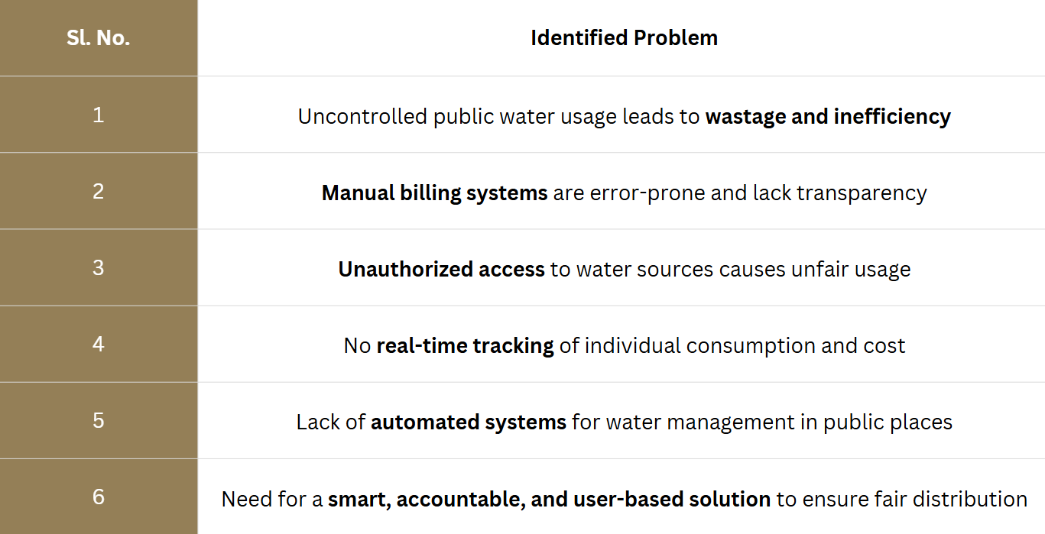

04
Problem Statement

Slide 5




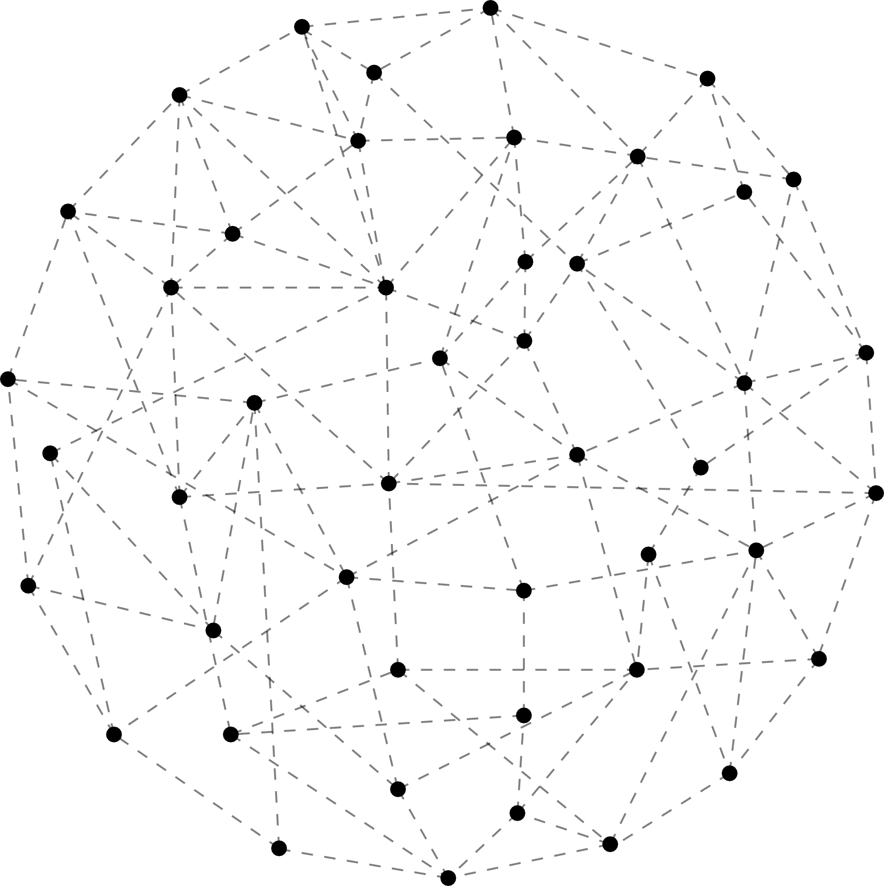
04
Project Description
A smart water dispensing system designed to reduce wastage and ensure fair billing.
Users authenticate themselves using RFID cards to access water.
Water flows only while the card is held in place.
Real-time billing is calculated based on the water used.
All usage data (volume and cost) is logged automatically to Google Sheets via WiFi.
Ideal for public water distribution points (e.g., WASA), schools, campuses, or community water stations.
5

Slide 6
04
Solution Approach
How It Works:
ESP32 acts as the central controller with built-in WiFi.
RFID Reader (RDM6300) reads the user's card and validates it.
Relay Module activates the Water Pump only while the card is present.
Billing and volume are calculated using time or flow-based logic.
LCD Display shows real-time usage and billing info to the user.
Data is automatically sent to Google Sheets for monitoring and billing logs.
6

Slide 7
04
Key Functionalities
RFID-Based User Authentication
Only authorized RFID card holders can access the dispenser.
Smart Water Dispensing
Water flows only while the RFID card is held near the reader.
Real-Time Usage Monitoring
Tracks how much the water is dispensed
Live Billing Calculation
Calculates cost based on usage volume.
LCD Display Feedback
Shows system status, amount used, and bill during operation.
Automated Data Logging
Sends usage and billing data to Google Sheets via WiFi.
Power Management
Voltage regulated using buck converter; relay controls high-power pump safely.
Manual ON/OFF Switch
System can be turned off manually for maintenance or emergencies.
7

Slide 8
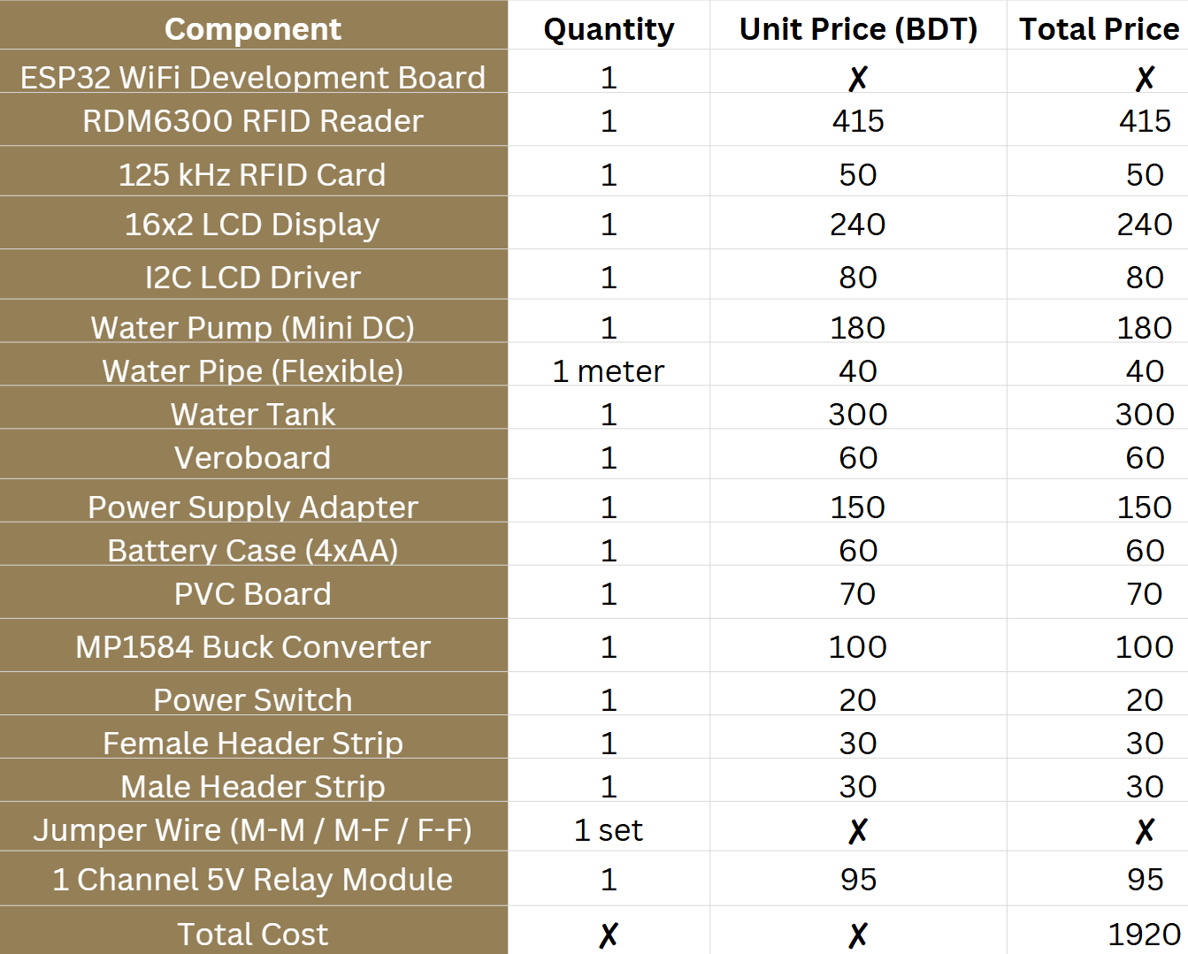

List of Required Equipment
8

Slide 9


17
Project DEtailed Plan
using Flowchart and System Diagram

Slide 10
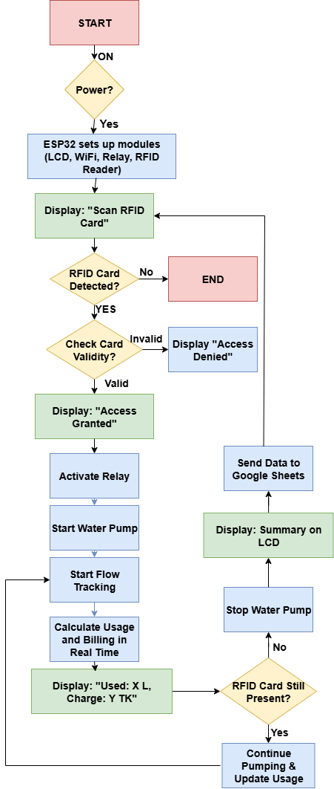
1. System Initialization
The system powers on via the Power Switch.
The ESP32 initializes all connected modules:
RDM6300 RFID Reader
16x2 LCD Display (via I2C Driver)
Relay Module
WiFi Connection Setup
LCD displays: "Scan RFID Card"
4. Live Usage & Billing
A timer or flow sensor tracks how long the pump is active (water flow duration).
The ESP32 calculates:
Volume used (optional: based on time or flow rate calibration)
Billing amount (e.g., 1 Litre = X Taka or per second)
Display updates continuously:
"Used: 1.25L"
"Bill: 2.50 TK"
2. User Authentication
User taps or holds the 125 kHz RFID Card near the RDM6300 reader.
The ESP32 reads the RFID UID and checks authorization (either from a local list or Firebase/Google Sheets).
If unauthorized, LCD shows "Access Denied" and resets.
5. Stop Dispensing
When the user removes the RFID card, the ESP32:
Deactivates the Relay, stopping the Water Pump.
LCD shows "Dispensing Stopped" and summary of usage.
6. Data Upload to Cloud
The ESP32 sends the data via WiFi to Google Sheets (using Apps Script + HTTPS or integration platforms like IFTTT or Blynk):
Card UID
Time & date
Amount of water dispensed
Total charge
3. Start Water Dispensing
If the card is valid:
LCD shows "Access Granted" and starts showing "Water Flowing...".
ESP32 activates the 5V Relay, turning on the Water Pump.
Water flows through the Water Pipe from the Water Tank.
7. Ready for Next User
System resets to "Scan RFID Card" for the next user.
Process repeats.
10

Slide 11
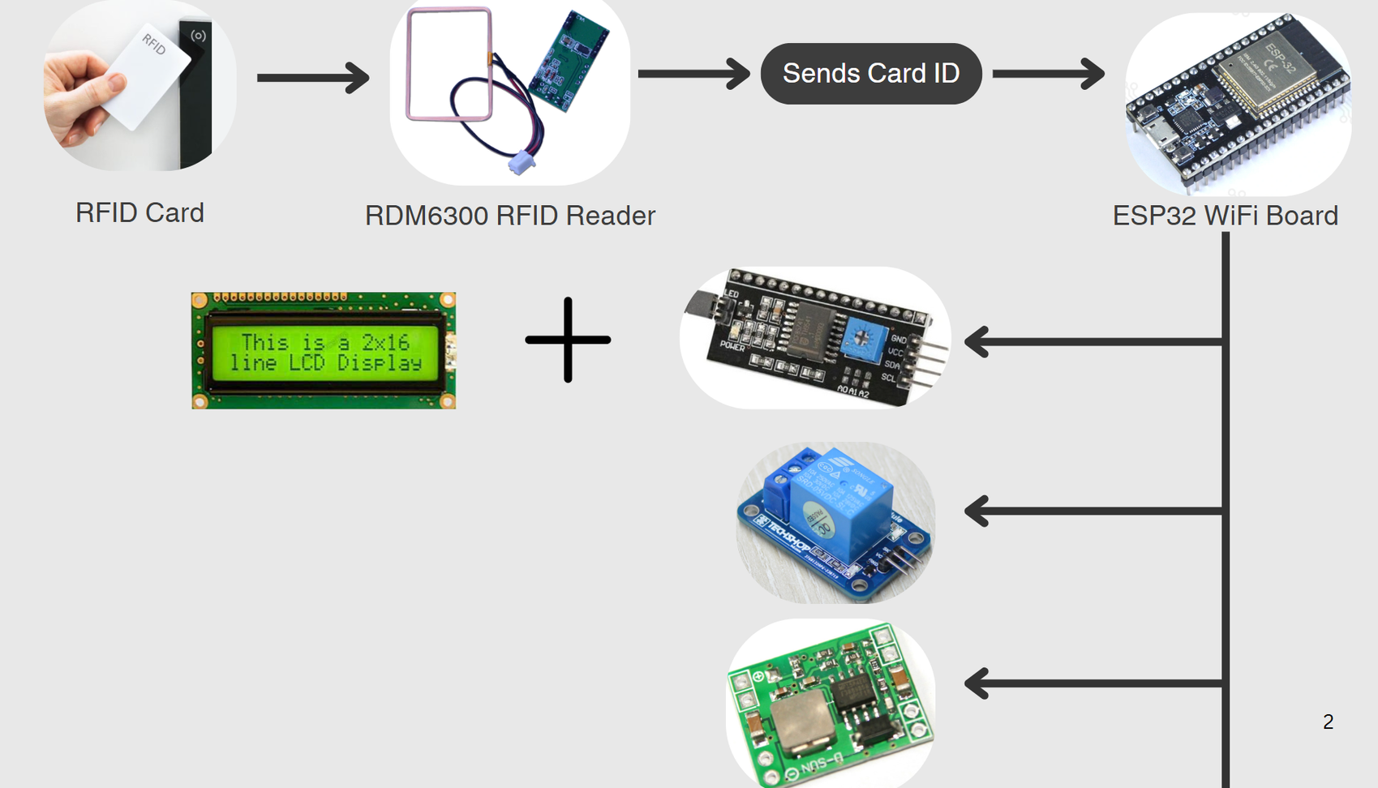




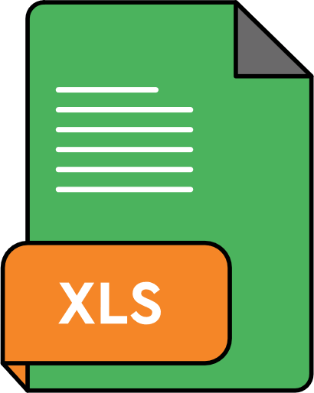

show status, billing
16x2 LCD Display +
I2C LCD Driver
switch ON/OFF
Relay Module (1 Channel 5V)
Power Supply
(MP1584 Buck Converter)
Water Pipe → Water Outlet
Google Sheets for billing & usage tracking
Data sent via WiFi
Power Switch (manual ON/OFF)

Slide 12


05
Background Study / Gap Analysis
[3] RFID + IoT in Water Vending (ResearchGate)
• Components: NodeMCU, RFID, Ultrasonic Sensor, Relay, GSM
• Functionality: RFID access, tank level sensing, alerts via GSM
• Specialty: Combines IoT + water level + GSM alerts
Gap: Focus is more on vending control, not detailed billing or usage-based payment tracking
[1] Instructables – Water Dispenser IoT Project
• Components: ESP8266, RFID Module, Relay, LCD, Pump
• Functionality: RFID triggers pump, shows status on LCD, logs via Blynk
• Specialty: DIY-friendly, easy Wi-Fi setup, basic IoT structure
• Gap: No real-time billing or Google Sheets logging; lacks secure ID validation and large-scale tracking
[4] IJARSCT – IoT Water Management for Rural Areas
• Components: Arduino, RFID, Relay, LCD, Pump
• Functionality: RFID access to enable pump, shows info on LCD
• Specialty: Simplicity for low-tech rural deployment
• Gap: No billing logic or cloud sync; doesn't track individual usage
[2] Smart Water ATM (MDPI, Electronics)
• Components: Arduino Uno, RFID Reader, Flow Sensor, Relay, LCD
• Functionality: RFID authentication, flow-based billing, LCD status
• Specialty: Real-time billing with flow rate sensing
• Gap: Does not integrate cloud storage like Google Sheets; lacks Wi-Fi automation for updates
[5] Academia – Smart Water Dispenser Using RFID
• Components: Arduino, RFID, IR Sensor, LCD, Pump
• Functionality: RFID activates pump; IR detects cup/glass
• Specialty: Safety mechanism for unattended dispensing
• Gap: No billing/tracking system; system is offline only

Slide 13
05
Background Study / Gap Analysis
[8] IJARST – Smart Liquid Dispensing Machine
• Components: RFID, Solenoid Valve, Arduino, LCD
• Functionality: Dispenses set amount after authentication
• Specialty: Precise, fixed-volume dispensing system
• Gap: Does not measure actual usage; lacks billing customization and tracking
[6] GitHub – Smart Water Dispenser System
• Components: ESP32/Arduino, RFID, Ultrasonic Sensor, Relay
• Functionality: RFID for access, tank level sensing, control logic
• Specialty: Open-source and modular design
• Gap: Lacks billing integration and real-time cloud database
[9] IJIRT – Automatic Water Dispenser Using IoT
• Components: Arduino, RFID, Solenoid Valve, Relay, LCD
• Functionality: Dispenses a predefined quantity on RFID scan
• Specialty: Fixed pricing model for community water supply
• Gap: No cloud integration; does not allow dynamic billing based on use
[7] IJCRT – Automatic Water Dispenser Using IoT
• Components: RFID, Arduino, Flow Sensor, Pump, Relay
• Functionality: Dispenses water based on flow time
• Specialty: Simple but effective billing logic
• Gap: No RFID-based user logging or data backup via internet
[10] Smart Water Dispenser Monitoring System (Conf. Proc.)
• Components: RFID, Ultrasonic Sensor, WiFi Module, Relay
• Functionality: RFID-based access + water level monitor
• Specialty: Adds monitoring analytics
• Gap: No detailed user billing or integration with billing APIs like Google Sheets

Slide 14



28
Conclusion
The RFID-enabled Smart Water Dispensing System offers an innovative, efficient, and accountable solution to modern water distribution challenges. By integrating IoT, automation, and real-time billing, it ensures fair usage, prevents wastage, and promotes digital water management. This system can significantly contribute to sustainable water practices in both urban and rural areas.
14

Slide 15
Reference
29
[1] Instructables Team, “Water Dispenser IoT Project,” Instructables, 2024. [Online]. Available: https://www.instructables.com/Water-Dispenser/
[4] P. Kumari and R. Sinha, “IoT Based Water Management System using RFID for Rural Areas,” International Journal of Advanced Research in Science, Communication and Technology (IJARSCT), vol. 4, no. 5, pp. 123–130, 2024. [Online]. Available: https://ijarsct.co.in/A16820.pdf
[2] K. Abubakar, M. Tariq, and S. R. Ali, “Smart Water ATM with Arduino Integration, RFID Authentication, and Dynamic Dispensing,” Electronics, vol. 13, no. 9, p. 1657, 2024. [Online]. Available: https://www.mdpi.com/2079-9292/13/9/1657
[5] N. Jaiswal and R. Jaiswal, “Smart Water Dispenser Using RFID Reader,” Project Report, Academia.edu, 2023. [Online]. Available: https://www.academia.edu/42654070
[3] H. Ahmed, “Advancing Water Vending Industry through RFID and IoT Empowerment,” International Conference on Advanced Electrical and Electronics Engineering (ICAEEE), 2024. [Online]. Available: https://www.researchgate.net/publication/381693362
[6] A. Labrahmi, “Arduino Smart Water Dispenser System,” GitHub Project Repository, 2022. [Online]. Available: https://github.com/Labrahmi/water-dispenser-system

Slide 16
Reference
30
[7] S. Jain, M. Yadav, and D. Kumar, “Automatic Water Dispenser Using IoT,” International Journal of Creative Research Thoughts (IJCRT), vol. 12, no. 4, pp. 88–91, 2024. [Online]. Available: https://ijcrt.org/papers/IJCRT24A3196.pdf
[9] A. Patel, R. Bhatt, and S. Shah, “Automatic Water Dispenser Using IoT,” International Journal of Innovative Research in Technology (IJIRT), vol. 11, no. 3, pp. 112–117, 2024. [Online]. Available: https://ijirt.org/publishedpaper/IJIRT164235_PAPER.pdf
[8] V. K. Singh, “Design and Construction of a Smart Liquid Dispensing Machine,” International Journal of Advanced Research in Science and Technology (IJARST), vol. 9, no. 2, pp. 55–60, 2023. [Online]. Available: https://www.ijarst.in/public/uploads/paper/951851654145888.pdf
[10] R. Deshmukh and P. Joshi, “Smart Water Dispenser Monitoring System,” International Conference Proceedings on Embedded and IoT Systems, 2020.

Slide 17

ANY
Question?

